Slide 1
Document Object Model (DOM)
David Tarvin, AIM Code School

Slide 2
What is the Document Object Model (DOM)?
It is a representation of the HTML that makes up the web page
When a web page is loaded, the following happens:
The JavaScript engine analyzes the HTML
The JavaScript converts the HTML into an internal format that the runtime environment can actually run.
This internal format is called the DOM tree.
The act of analyzing and converting is called parsing the document.
The browser then builds up a model of the document’s structure
The browser then uses the model to draw the page on the screen
The model of the document is a live data structure that you can read from and change
When it is modified, the page on the screen is updated to reflect the changes

Slide 3
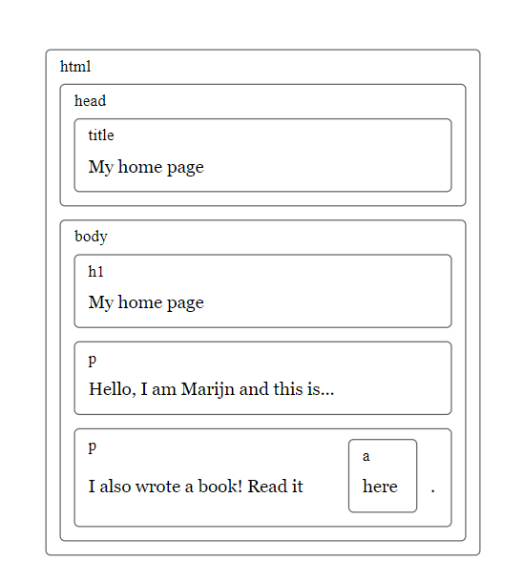
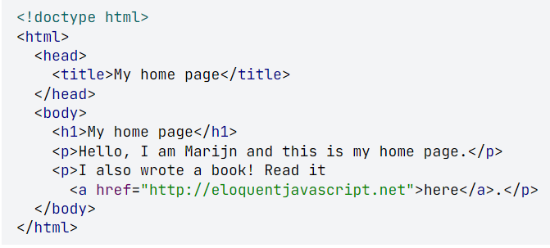
An HTML document is like a series of nested boxes. Tags such as <body> and </body> enclose other tags, which in turn contain other tags or text.

Slide 4
What is the Document Object Model (DOM)? (cont’d)
The data structure the browser uses to represent the HTML document follows this nested box shape
For each box, there is an object with which we can interact to find out things such as:
What HTML tag it represents
Which boxes and text it contains
This representation is called the Document Object Model, or DOM, for short
The global variable document gives us access to these objects
Its documentElement property refers to the object representing the HTML tag
It also provides the properties head and body, which hold the objects for those elements

Slide 5
Trees
A DOM is like a tree in that it is composed of many branches
Each element is referred to as a node
Each node may refer to other nodes, referred to as children, which in turn may have their own children
For a data structure to be a tree, it must have the following:
A branching structure
No cycles (a node may not contain itself, directly or indirectly)
A single, well-defined root (the root of the DOM is document.documentElement

Slide 6
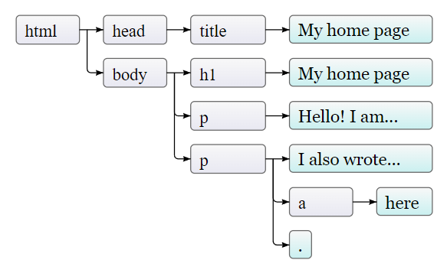
Trees (cont’d)
Nodes for regular elements, which represent HTML tags, determine the structure of the document
Those nodes can have child nodes. An example is document.body
Some child nodes can be leaf nodes containing pieces of text or HTML comments
In the picture, the leaves are text nodes, and the arrows indicate parent-child relationships between nodes

Slide 7
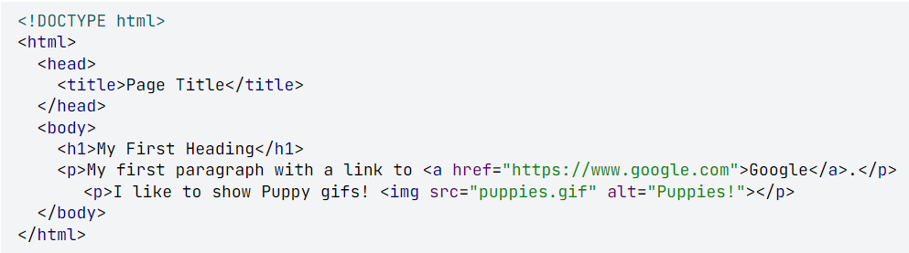
Quiz Time!!!
How many children does the body have?
How many root nodes are there?
Is DOCTYPE the root element?
Is the img element a node, given that it’s self closing?
Is the a node a child of anyone? If so, who?
How many total nodes are there in the tree?

Slide 8

DOM Construction Order
Once the HTML is parsed in the browser, the DOM gets constructed depth first from top to bottom
This means the browser starts at the top, then includes elements down and deeper into nested elements before going down
html
--head
----title
--body
----h1
----p (first one)
----p (second one)
------a

Slide 9
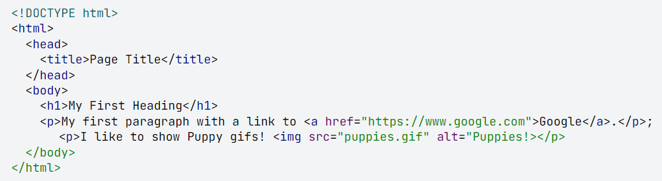
DOM Construction Order (cont)
In what order are these elements constructed?
html
--head
----title
--body
----h1
----p (first one)
------a
----p (second one)
------img

Slide 10
Why do we need to put the <script> tag at the end of the body?
The DOM gets constructed from the top down
If a <script> tag is in the <head> element, the script will most likely be loaded and run before the rest of the DOM is constructed
If that <script> tag refers to an element in the DOM, that element will not be there when the script is run

Slide 11
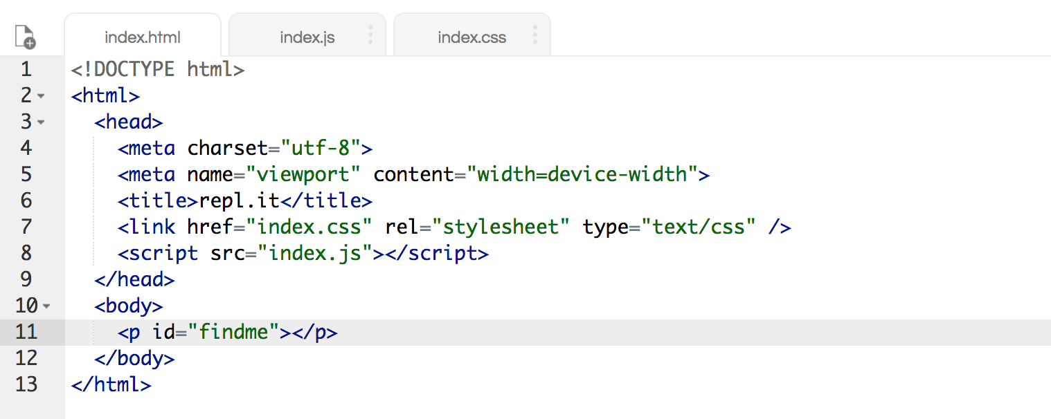
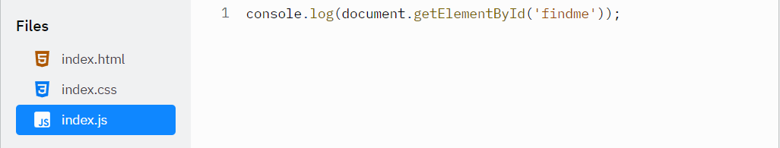
Let’s test it! First in the head…

Slide 12
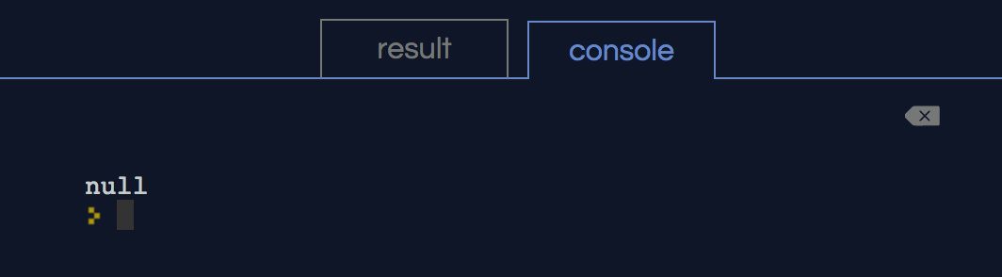
<script> tag in the head - result

Slide 13
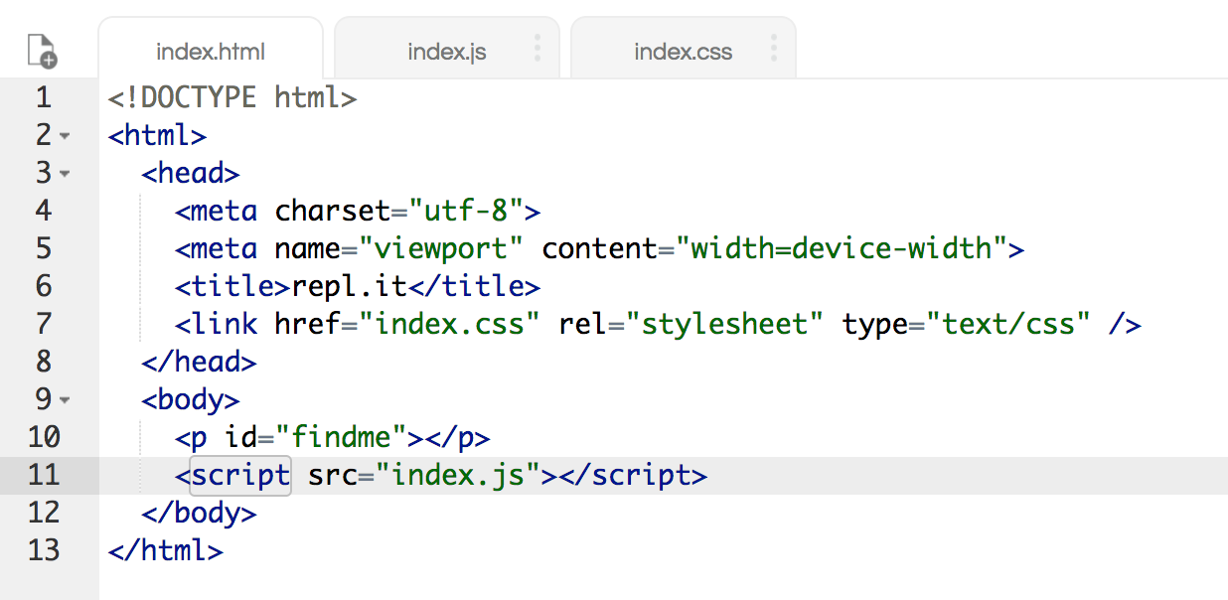
Now let’s place it at the bottom of the body…

Slide 14
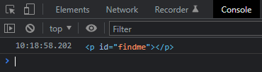
<script> tag at the bottom of the body - result

Slide 15
DOM – Finding elements
Trying to find a specific node in the document by starting at document.body and following a hard-coded path of links is a bad idea
Bakes assumptions into our program about the precise structure of the document – a structure we may want to change later
Another complicating factor – text nodes are created even for the whitespace between nodes

Slide 16
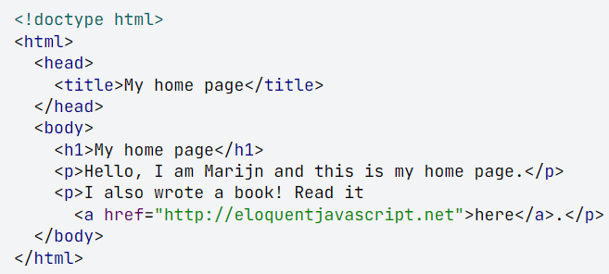
DOM – Finding elements (cont’d)
The <body> does not have just three children (the <h1> and two <p>) but actually has seven
- The <h1>, the two <p>, plus the spaces before, after and between them
- If we want to get the href attribute of the link, we don’t want to say, “get the second child of the sixth child of the document body.”
- better to say “get the first link in the document.” And we can.

Slide 17
Retrieving elements
All element nodes have a getElementsByTagName method
Collects all elements with the given tag name that are descendants of the give node
Returns them as an array-like object
To find a specific single node, give it an id attribute and use document.getElementById
A similar method, getElementsByClassName, searches through all the contents of an element node and retrieves all elements that have the given string in their class attribute

Slide 18
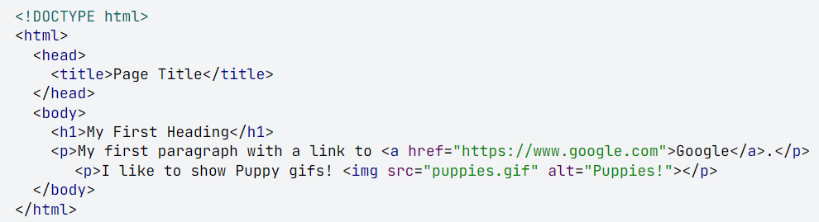
What is the simplest way to get the img element from the HTML below?

Slide 19
querySelector and querySelectorAll
querySelectorAll is defined on both the document object and on element nodes
It takes a selector string and returns an array-like object containing all the elements that it matches
Unlike methods such as getElementsByTagName, the object returned by querySelectorAll is not live
It wont change when you change the document
querySelector is similar, but it returns only the first matching element, or null if no elements match
Useful if you want a specific, single element

Slide 20
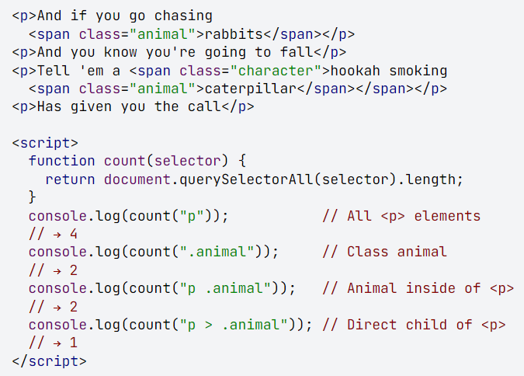
querySelectorAll - example

Slide 21
Attributes and Text Content
Some element attributes, such as href, can be accessed through a property of the same name on the element’s DOM object
True for a limited set of commonly used standard attributes
BUT HTML allows you to set any attribute you want on nodes
This allows you to store extra information in a document
Made-up attributes will not be present as a property on the element’s node
Use the getAttribute and setAttribute methods to work with them
It is recommended to prefix such made-up attributes with data- to ensure they do not conflict with any other attributes

